Slide 1
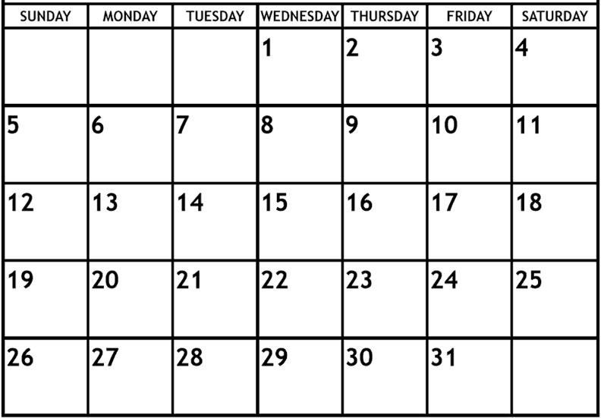
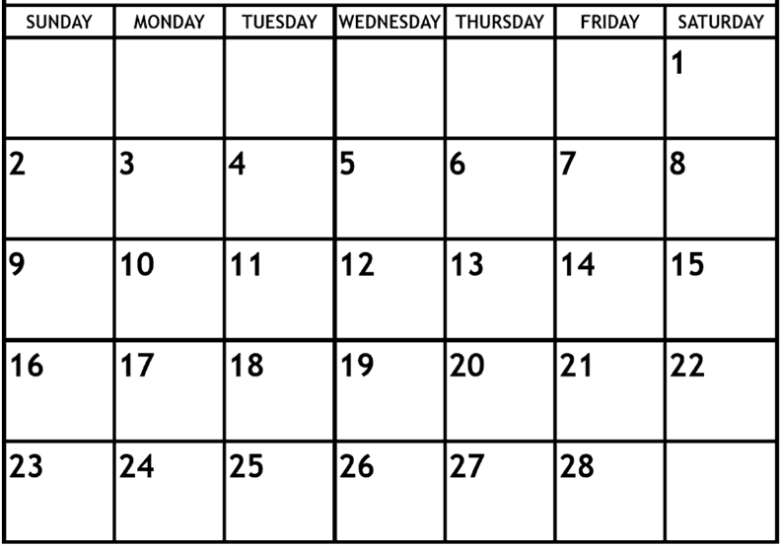
Pack/Troop ### Calendar – Spring Semester, 2025
Shift/use text boxes and examples below to customize with events and reminders for your Unit – delete this text box before sharing
Dates and plans are accurate as of December 2024. Any unanticipated changes to this calendar will be communicated as soon as they are known.
Note: Webelos II should begin visiting area Troops this month in advance of cross over; leaders will have lists
Text box
Text box
No school – MLK Jr. Day
Text box
Scout Sunday - attend service, activity after
Text box
Text box
No school – Presidents Day
Text box

Slide 2
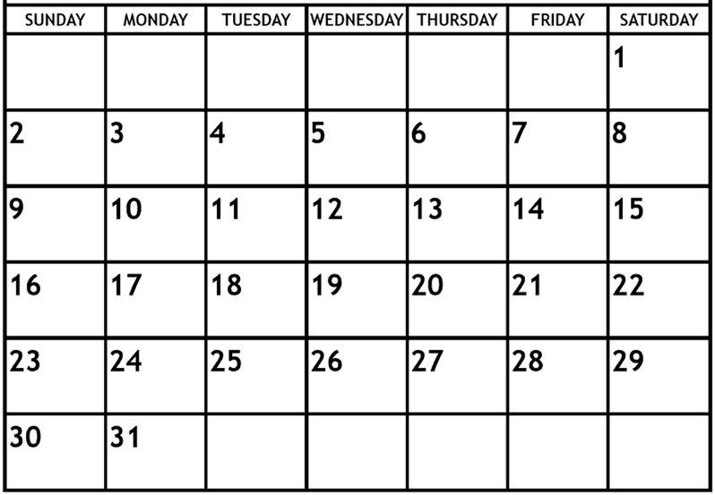
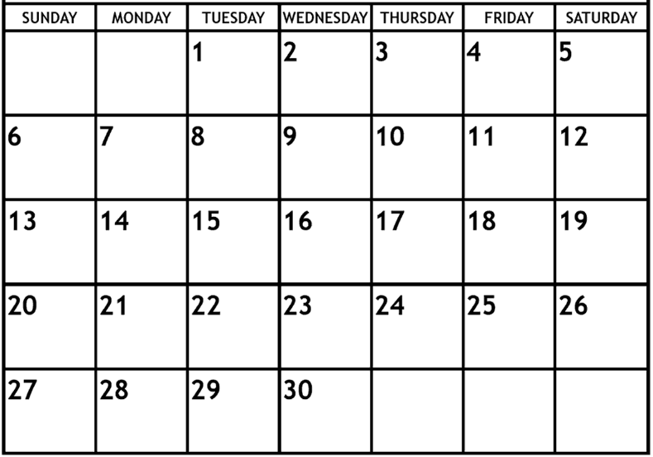
Text box
Text box
Text box
******* No school – EVSC Spring Break *******
EVSC no school (potential make up day)
Easter

Slide 3
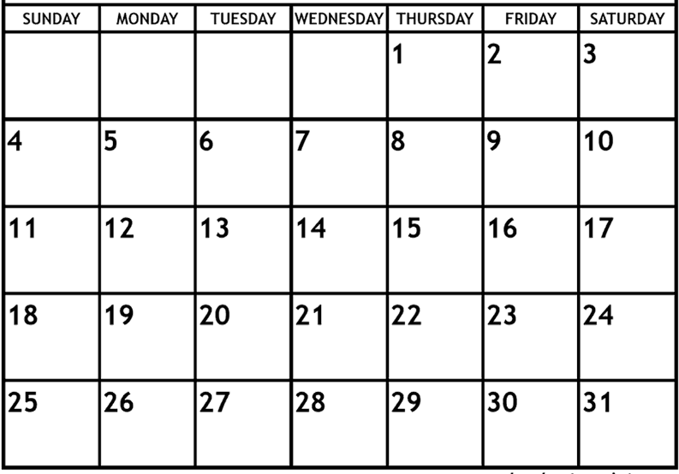
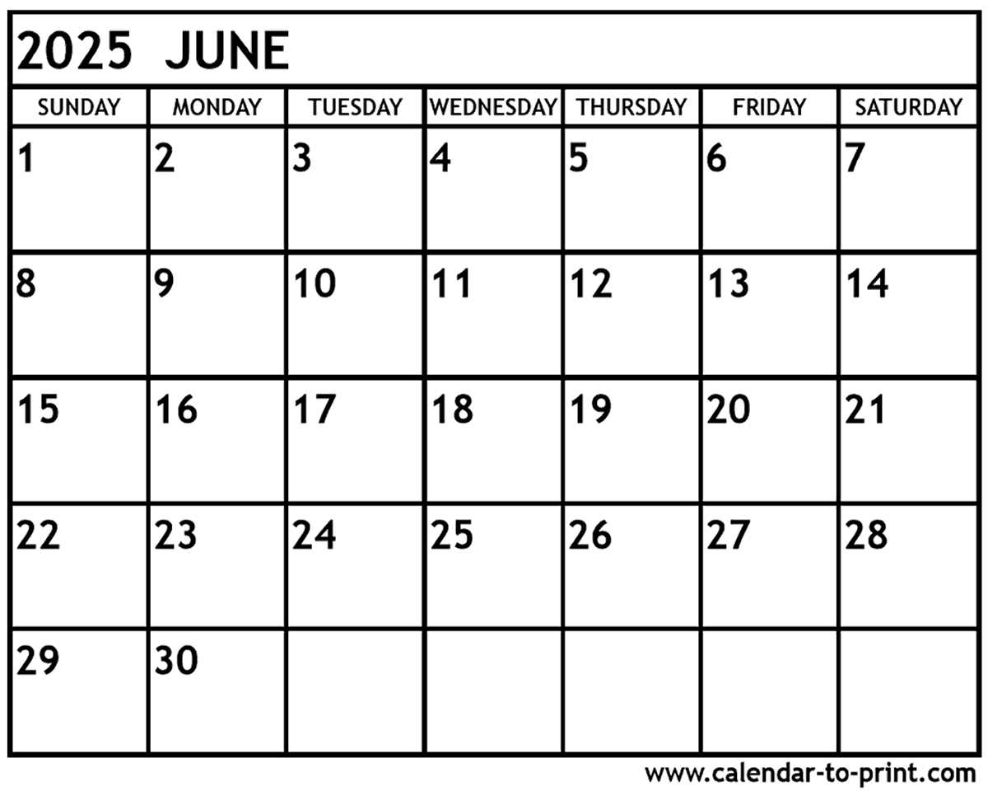
EVSC no school (potential make up day)
Text box
Text box
Mother’s Day
Text box
Be sure to include Cub Scout Day Camp on this month in the right week for your district
Father’s Day
Summer Dates to Note
Date/time/activity
Date/time/activity

