Slide 1
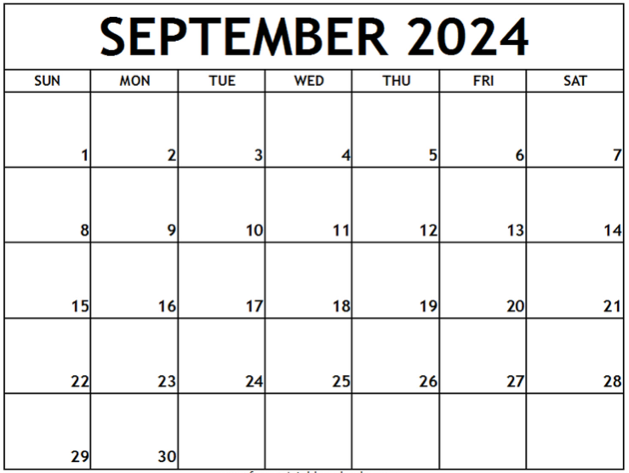
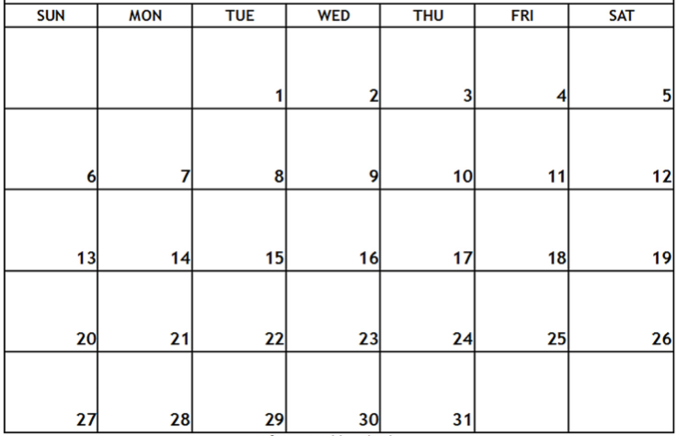
Pack/Troop ### Calendar – Fall Semester, 2024
Shift/use text boxes and examples below to customize with events and reminders for your Unit – delete this text box before sharing
Day, August __ – first Pack/Den/Troop meeting, time, location
Day, August __ – event, time location
Labor Day
Text box
Fall Fun Day
Popcorn Distribution
Popcorn Blitz Weekend
Text box
text box
text box
There will popcorn storefront sales opportunities during the weeks of sales season—usually 2 hour shifts on weekends.
Text box
EVSC No School
Text box
********** West Side Nut Club Fall Festival – October 7-12 **********
******* EVSC Fall Break – No School **********
text box
(popcorn orders due)

Slide 2
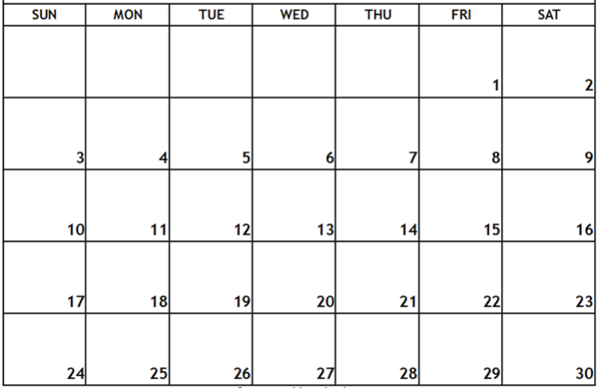
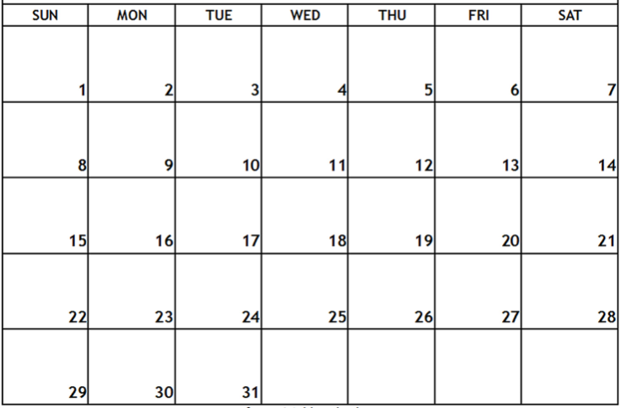
Text box
EVSC No School – Election Day
Text box
text box
Popcorn Payment Due
No school – Happy Thanksgiving
Text box
Text box
text box
No school– December 23 – January 6 – Merry Christmas, Happy New Year, enjoy your break!
Jan-May 2025 calendar to come…here are first dates in January
Date/event
Date/event

