Slide 1
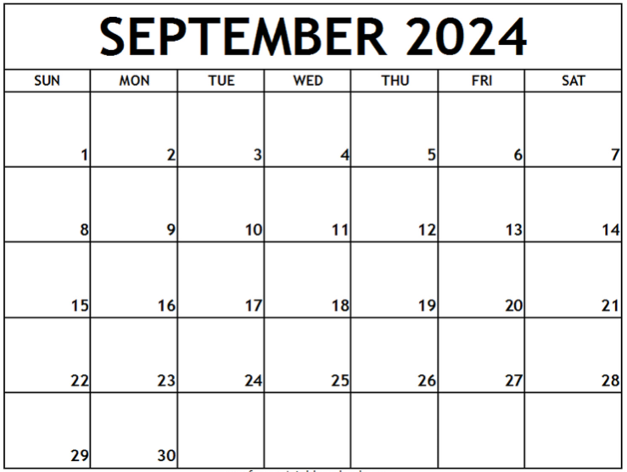
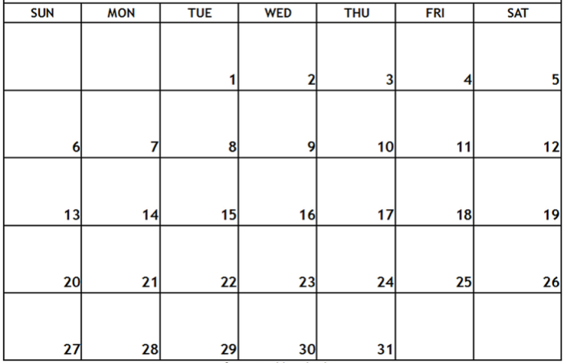
Pack/Troop ### Calendar – Fall Semester, 2024
Shift/use text boxes and examples below to customize with events and reminders for your Unit – delete this text box before sharing
Day, August __ – first Pack/Den/Troop meeting, time, location
Day, August __ – event, time location
Labor Day
Text box
Text box
text box
text box
Popcorn Blitz Weekend
There will popcorn storefront sales opportunities during the weeks of sales season—usually 2 hour shifts on weekends.
Text box
EVSC No School
Text box
********** West Side Nut Club Fall Festival – October 7-12 **********
******* EVSC Fall Break – No School **********
text box
(popcorn orders due)

Slide 2
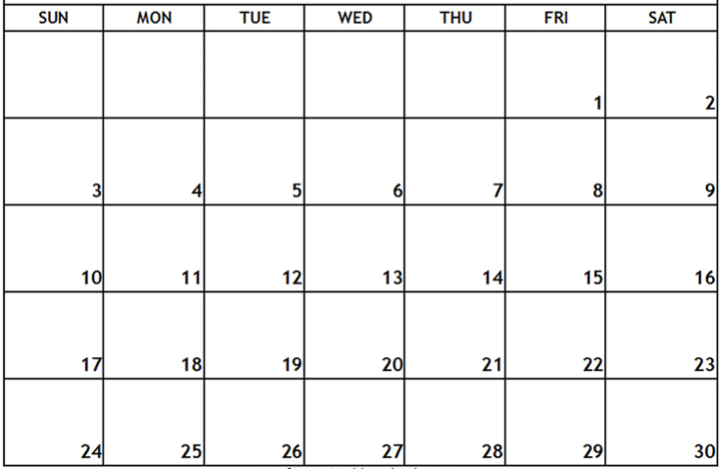
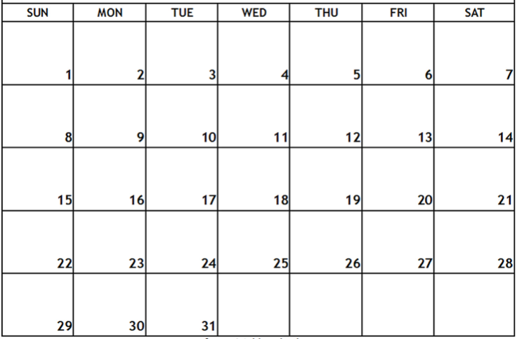
Text box
EVSC No School – Election Day
Text box
text box
No school – Happy Thanksgiving
Text box
Text box
text box
No school– December 23 – January 6 – Merry Christmas, Happy New Year, enjoy your break!
Jan-May 2025 calendar to come…here are first dates in January
Date/event
Date/event

