Slide 1
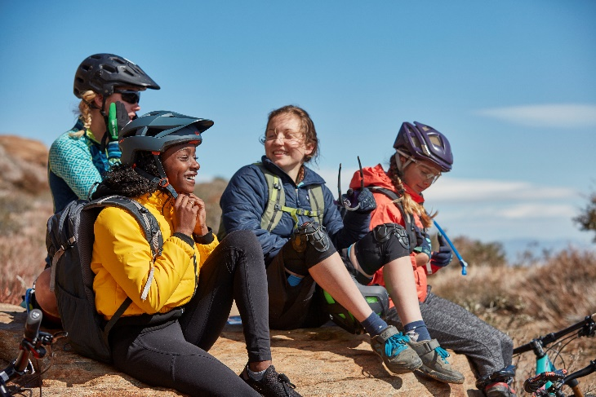
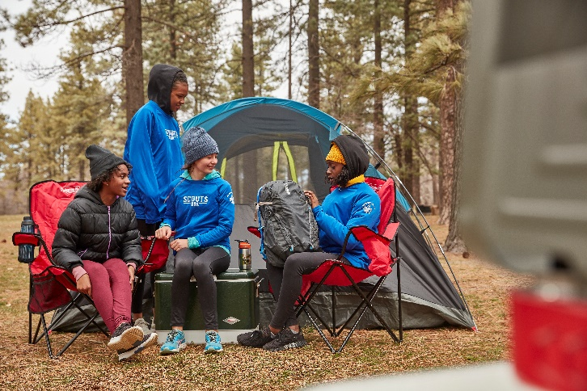
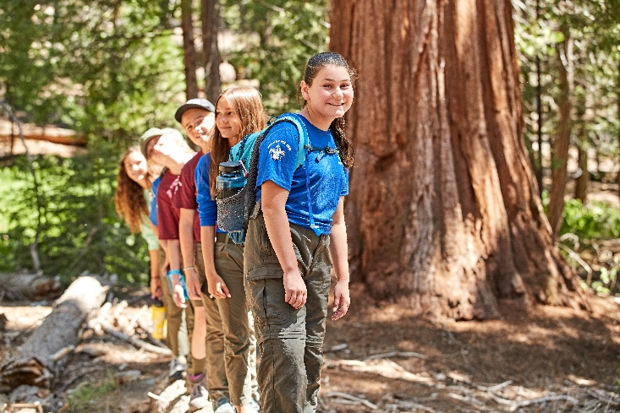
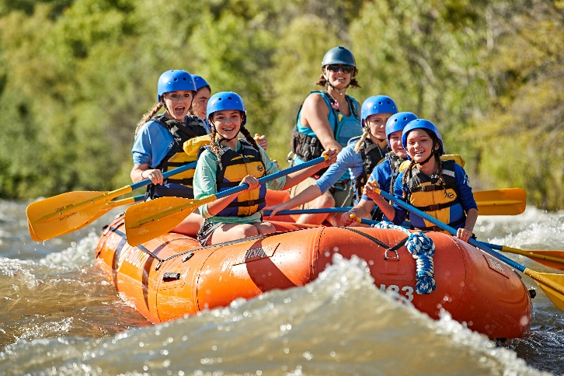
Troop ###
welcoming GIRLS ages 11 (entering 6th) through 17
Scouts BSA is about…
Learning - Life Skills - Leadership
Well-Being - Resilience - Adventure
Making Friends - Character & Service
Find us online/on Facebook
We regularly meet at (location, day of week, time) OR recruitment event day/time/details
QR Code to Facebook page or beascout pin

